Slide 1
Texas Community Development Block Grant Program
CDBG Over Coffee: 54 Years of the Fair Housing Act

Slide 2
Notes:
Good Afternoon Everyone. Welcome to CDBG Over Coffee. We will be providing an overview of the Fair Housing Act and our obligation to comply with the Act. Before we get started, just a friendly reminder to please mute your lines at this time. Questions will be taken at the end of the presentation and can also be submitted through the Instant Message feature.
So grab your cup of coffee, and lets get started…

Slide 3
Fair Housing in Texas
The Texas Department of Agriculture (TDA) and the Texas Community Development Block Grant (CDBG) program are committed to affirmatively furthering Fair Housing.
Affirmatively furthering Fair Housing is a requirement of the CDBG program and TDA requires units of general local governments applying for CDBG funds to affirmatively further Fair Housing.

Slide 4
How Does TDA Support Fair Housing?
TDA primarily provides CDBG funds for infrastructure in support of developing viable communities and providing suitable living environments.
This includes projects such as:
Water/Wastewater infrastructure
Street and drainage improvements with housing activities
Fire trucks, ambulance and service trucks
Downtown Revitalization
Planning, including public facility and housing planning activities
Notes:
The primary objective of the Community Development Block Grant program is to develop viable communities by providing decent housing and suitable living environments and expanding economic opportunities.
Eligible applicants are non-entitlement cities under 50,000 in population and non-entitlement counties that have a non-metropolitan population under 200,000 and are not eligible for direct CDBG funding from HUD may apply for funding through any of the Texas CDBG programs.

Slide 5
TDA & Fair Housing
Notes:
Here are some pictures of CDBG funded projects that help provide viable communities. These improvements are especially important for low-to-moderate income communities, which often serve a significant number of persons in protected classes.

Slide 6
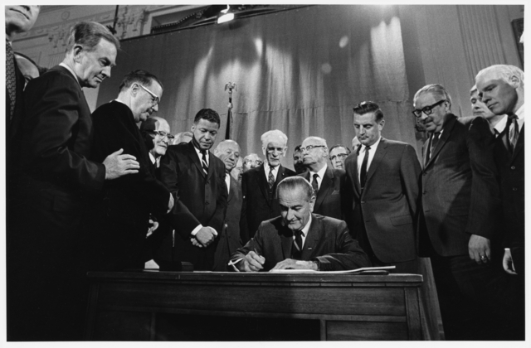
54 Years Ago
Dr. Martin Luther King, Jr.
President Lyndon B. Johnson signing the Fair Housing Act into law on April 11, 1968.
Notes:
The Fair Housing Act, was signed into law a week after the assassination of Dr. Martin Luther King Jr. Since the early years of the Act, Congress has continued to expand coverage for more protected classes.

Slide 7
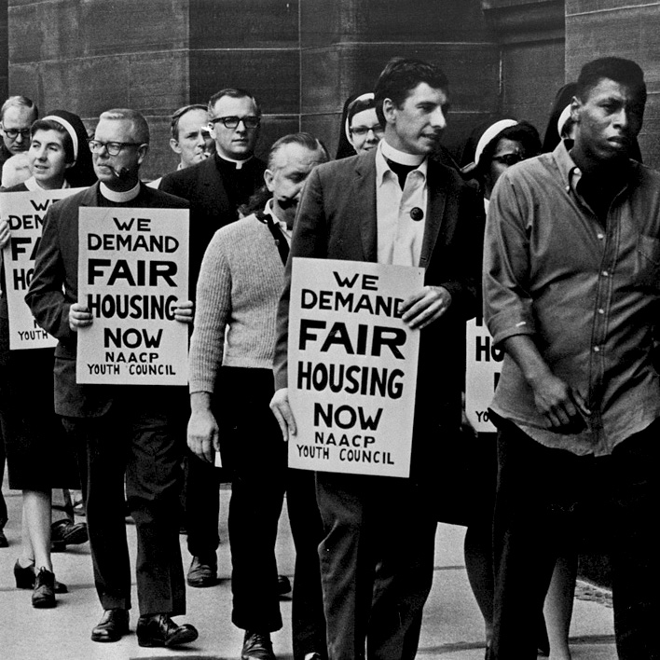
Fair Housing Act - Protected Classes
Race
Color
National Origin
Religion
Notes:
The original law enacted in 1968 protected against discrimination in the sale, rental, financing, and other prohibited practices in housing based on race, color, national origin, or religion.

Slide 8
Fair Housing Act - Protected Classes
In 1974 Congress added sex (gender) as a protected class.
Sex
Notes:
In 1974 Congress passed the Housing and Community Development Act and simultaneously added gender as a protected class to the Fair Housing Act. President Gerald Ford signed the HCDA into law on August 22, 1974.

Slide 9
Fair Housing Act - Protected Classes
Disability
Familial Status
In 1988 President Ronald Reagan signed the Fair Housing Amendments Act into law.
Notes:
In 1988 Congress expanded protections to two additional classes: disability and familial status. President Ronald Reagan signed the Fair Housing Amendments Act into law on March 13, 1988.

Slide 10
Fair Housing: Know Your Rights
The Federal Fair Housing Act and the Texas Fair Housing Act protect your rights to rent an apartment, buy a home, or obtain a mortgage, free from discrimination based on:
Race
Color
Disability
Sex
Religion
National Origin
Familial Status
Notes:
The 7 protected classes are race, color, disability, sex, religion, national origin and familial status.

Slide 11
Protected Classes
Race or Color
Race – The genetic makeup of the parents.
Ethnicity: 2 categories
Hispanic or Latino
Not Hispanic or Latino

Slide 12
Protected Classes
Disability
The Act defines persons with a disability to mean those individuals with mental or physical impairments that substantially limit one or more major life activities.
Mental Impairments
Physical impairment
Notes:
Blindness, hearing impairment, mobility impairment, HIV infection, mental retardation, alcoholism, drug addiction, chronic fatigue, learning disability, head injury, and mental illness.
Major life activity may include seeing, hearing, walking, breathing, performing manual tasks, caring for oneself, learning, speaking, or working.
Current users of illegal controlled substances, persons convicted for illegal manufacture or distribution of a controlled substance, sex offenders, and juvenile offenders are not considered disabled under the Fair Housing Act, by virtue of that status.
The Fair Housing Act affords no protections to individuals with or without disabilities who present a direct threat to persons or property of others.

Slide 13
Protected Classes
Sex/Gender/Marital Status
HUD’s Equal Access Rule provides protections from discrimination based on sexual orientation, gender identity, and marital status.
Protections from sex discrimination include:
Prohibition of sexual harassment
Discrimination because of sexual orientation
Discrimination because of gender identity
Discrimination because of marital status

Slide 14
Protected Classes
Religion
“Religion” includes both the practice and non-practice of religion, such as atheism, as well as religions that are outside the mainstream.
Overt discrimination against members of a particular religion.
Discrimination includes refusing to rent or sell, charging more, or offering different terms to someone because of his or her religion.
Notes:
Housing providers are prohibited from making discriminatory statements or publishing discriminatory advertising, as well as from making false statements about availability.

Slide 15
Protected Classes
National Origin
Ancestry
Birthplace
Ethnic Background
Limited English Proficiency (LEP)
Refers to a person's limited ability to read, write, speak or understand English.
Notes:
National origin discrimination is different treatment in housing because of a person’s ancestry, ethnicity, birthplace, culture or language, and it is illegal.
People cannot be denied housing because;
they or their family are from another country
they have a name or accent associated with a national origin group
because they participate in certain customs associated with a national origin group or
they are married to or associate with people of a certain national origin.

Slide 16
Protected Classes
Familial Status
Pregnancy
Parent/Legal custodian of child living with them who is under 18
Securing custody of a child
Notes:
For example, landlords may not locate families with children in any single portion of a complex, place an unreasonable restriction on the total number of persons who may reside in a dwelling, or limit their access to recreational services provided to other tenants. In most instances, the amended Fair Housing Act prohibits a housing provider from refusing to rent or sell to families with children.
However, some facilities may be designated as Housing for Older Persons (55 years of age). This type of housing, which meets the standards set forth in the Housing for Older Persons Act of 1995, may operate as "senior" housing. The Department of Housing and Urban Development (HUD) has published regulations and additional guidance detailing these statutory requirements.

Slide 17
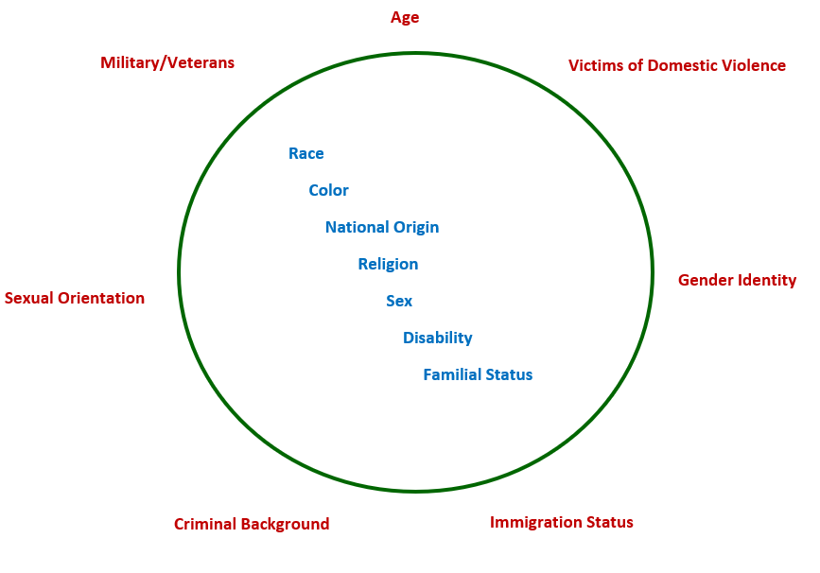
Fair Housing Act - Protected Classes
Notes:
Some fair housing advocates have called for Congress to expressly add more protected classes to the statute, such as age, military/veteran status, victims of domestic violence, sexual orientation, gender identity, criminal background, and immigration status. As with the U.S. Constitution, the Fair Housing Act is a dynamic document that continues to evolve.

Slide 18
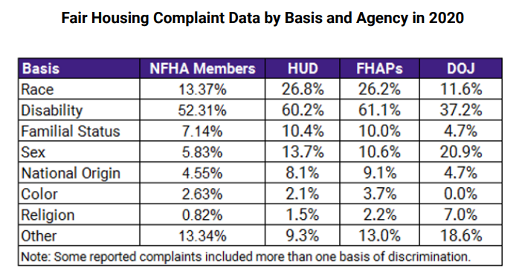
Fair Housing Act
Source: National Fair Housing Alliance 2021 Fair Housing Trends report.
Notes:
The Fair Housing Act today is alive and well and continues to deter discrimination in all protected categories. In this table, annual data compiled by the National Fair Housing Alliance shows that complaints for alleged discrimination based on disability are the most prevalent from any other protected class.

Slide 19
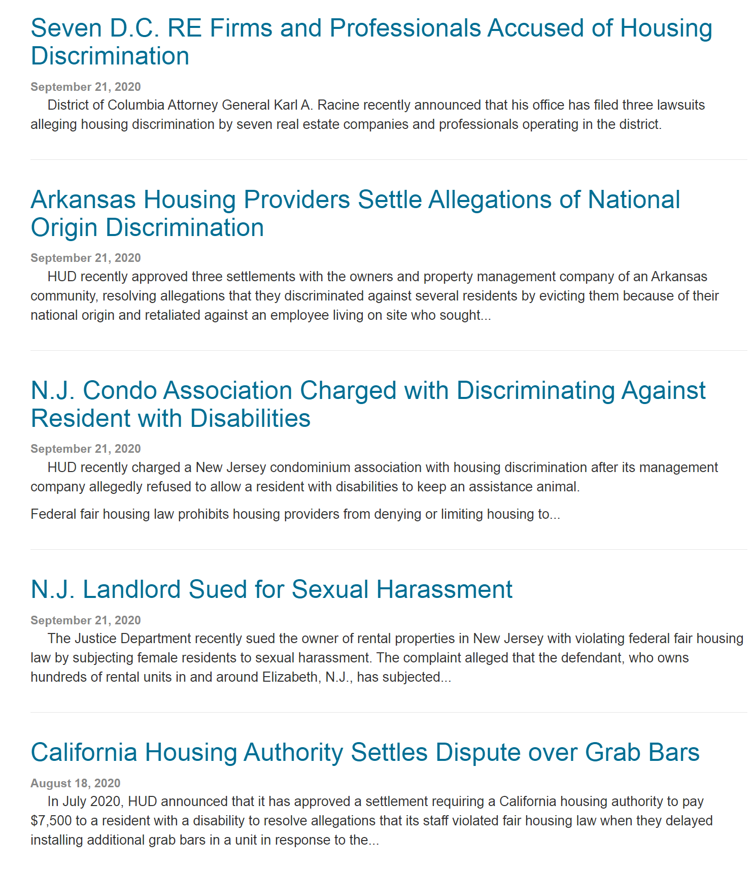
Fair Housing Act
Source: FairHousingCoach.com
Notes:
But complaints on behalf of all protected classes continue to be investigated and litigated.

Slide 20
Affirmatively Furthering Fair Housing
Assess Community Needs and Resources
Implement Effective Citizen Participation such as public hearings, community meetings, workshops, webinars, emails, publication in newspapers
Consultation with stakeholders and encourage public input
Notes:
Measures taken to affirmatively further fair housing are...

Slide 21
Fair Housing Resources
The 2021 National Fair Housing Alliance (NFHA) Fair Housing Trends Report.
https://nationalfairhousing.org/wp-content/uploads/2021/07/2021-Fair-Housing-Trends-Report_FINAL.pdf
The HUD Exchange National Fair Housing Training Academy webpage.
https://www.hudexchange.info/programs/nfhta/
The Texas Workforce Commission Civil Rights Division’s Civil Rights Reporter newsletter.
https://www.twc.texas.gov/partners/civil-rights-reporter
Notes:
Here are some additional resources for fair housing data, information, and related articles.

Slide 22
Questions or Comments?

